Slide 1
Classifiers and Object Representation
03/17/11
Computer Vision
CS 543 / ECE 549
University of Illinois
Derek Hoiem

Slide 2
HW2 graded
mean 89, median 95

Slide 3
Today’s class: classifiers and objects
More about classifiers
Object categories and representation

Slide 4




Image Categorization
Training
Training Labels
Training Images
Image Features
Classifier Training
Trained Classifier

Slide 5
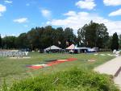
Image Categorization
Training
Training Labels
Training Images
Image Features
Classifier Training
Trained Classifier
Testing
Image Features
Trained Classifier
Prediction
Outdoor
Test Image

Slide 6
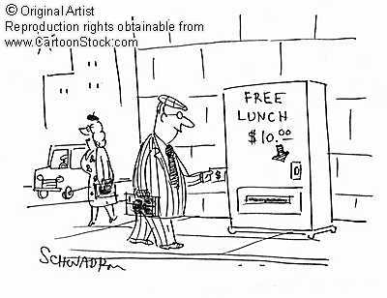
Remember…
No classifier is inherently better than any other: you need to make assumptions to generalize
Three kinds of error
Inherent: unavoidable
Bias: due to over-simplifications
Variance: due to inability to perfectly estimate parameters from limited data

Slide 7
How to reduce variance?
Choose a simpler classifier
Regularize the parameters
Get more training data
Notes:
The simpler classifier or regularization could increase bias and lead to more error.

Slide 8
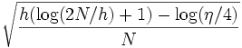
How to measure complexity?
VC dimension
Maximum number of examples that the classifier can perfectly classify for arbitrary labelings
Other ways: number of parameters, etc.
Upper bound on generalization error
Training error +
N: size of training set
h: VC dimension
η: 1-probability that bound holds

Slide 9
Very brief tour of some classifiers
SVM
Neural networks
Naïve Bayes
Bayesian network
Logistic regression
Randomized Forests
Boosted Decision Trees
K-nearest neighbor
RBMs
Etc.

Slide 10
Generative vs. Discriminative Classifiers
Generative Models
Represent both the data and the labels
Often, makes use of conditional independence and priors
Examples
Naïve Bayes classifier
Bayesian network
Models of data may apply to future prediction problems
Discriminative Models
Learn to directly predict the labels from the data
Often, assume a simple boundary (e.g., linear)
Examples
Logistic regression
SVM
Boosted decision trees
Often easier to predict a label from the data than to model the data
Notes:
Generative classifiers try to model the data. Discriminative classifiers try to predict the label.

Slide 11
K-nearest neighbor
x
x
x
o
x
x
x
+
o
o
x
x
o
o
+
o
o
x2
x1

Slide 12
1-nearest neighbor
x
x
x
o
x
x
x
+
o
o
x
x
o
o
+
o
o
x2
x1

Slide 13
3-nearest neighbor
x
x
x
o
x
x
x
+
o
o
x
x
o
o
+
o
o
x2
x1

Slide 14
5-nearest neighbor
x
x
x
o
x
x
x
+
o
o
x
x
o
o
+
o
o
x2
x1

Slide 15
Using K-NN
Simple, a good one to try first
With infinite examples, 1-NN provably has error that is at most twice Bayes optimal error

Slide 16
Naïve Bayes
y
x₁
x₂
x₃

Slide 17
Using Naïve Bayes
Simple thing to try for categorical data
Very fast to train/test

Slide 18
Classifiers: Logistic Regression
Maximize likelihood of label given data, assuming a log-linear model
x
x
x
x
x
x
male
o
x
x
o
o
Height
o
female
o
x2
x1
Pitch of voice

Slide 19
Using Logistic Regression
Quick, simple classifier (try it first)
Outputs a probabilistic label confidence
Use L2 or L1 regularization
L1 does feature selection and is robust to irrelevant features but slower to train

Slide 20
Classifiers: Linear SVM
x
x
x
x
x
x
o
x
x
o
o
o
o
x2
x1

Slide 21
Classifiers: Linear SVM
x
x
x
x
x
x
o
x
x
o
o
o
o
x2
x1
Notes:
Maximizes a margin

Slide 22
Classifiers: Linear SVM
x
x
x
o
x
x
x
o
x
x
o
o
o
o
x2
x1

Slide 23
Classifiers: Kernelized SVM
x
x
o
o
o
x
x
x
x
x
o
o
x²
o
x
x
x

Slide 24
Using SVMs
Good general purpose classifier
Generalization depends on margin, so works well with many weak features
No feature selection
Usually requires some parameter tuning
Choosing kernel
Linear: fast training/testing – start here
RBF: related to neural networks, nearest neighbor
Chi-squared, histogram intersection: good for histograms (but slower, esp. chi-squared)
Can learn a kernel function

Slide 25
Classifiers: Decision Trees
x
x
x
o
x
x
x
o
x
o
x
o
o
o
o
x2
x1

Slide 26
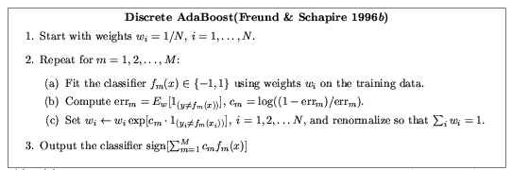
Ensemble Methods: Boosting
figure from Friedman et al. 2000

Slide 27
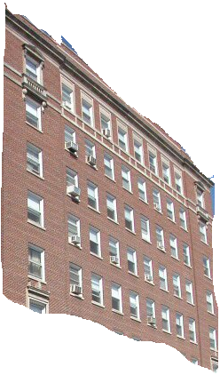
Boosted Decision Trees
High in
Image?
Gray?
Yes
No
Yes
No
Smooth?
Green?
High in
Image?
Many Long
Lines?
…
Yes
No
Yes
No
Yes
No
Yes
No
Blue?
Very High
Vanishing
Point?
Yes
No
Yes
No
Ground Vertical Sky
P(label | good segment, data)
[Collins et al. 2002]

Slide 28
Using Boosted Decision Trees
Flexible: can deal with both continuous and categorical variables
How to control bias/variance trade-off
Size of trees
Number of trees
Boosting trees often works best with a small number of well-designed features
Boosting “stubs” can give a fast classifier

Slide 29
Clustering (unsupervised)
+
x
+
o
+
+
+
x
x
x
+
+
x
+
+
o
x
x
+
o
+
o
+
o
x2
x2
x1
x1

Slide 30
Two ways to think about classifiers
What is the objective? What are the parameters? How are the parameters learned? How is the learning regularized? How is inference performed?

Slide 31
Ideals for a classification algorithm
Objective function: encodes the right loss for the problem
Parameterization: takes advantage of the structure of the problem
Regularization: good priors on the parameters
Training algorithm: can find parameters that maximize objective on training set
Inference algorithm: can solve for labels that maximize objective function for a test example

Slide 32
Two ways to think about classifiers
What is the objective? What are the parameters? How are the parameters learned? How is the learning regularized? How is inference performed?
How is the data modeled? How is similarity defined? What is the shape of the boundary?

Slide 33
Comparison
assuming x in {0 1}
Learning Objective
Training
Inference
Naïve Bayes
Logistic Regression
Gradient ascent
Linear SVM
Linear programming
Kernelized SVM
complicated to write
Quadratic programming
Nearest Neighbor
most similar features → same label
Record data

Slide 34
What to remember about classifiers
No free lunch: machine learning algorithms are tools, not dogmas
Try simple classifiers first
Better to have smart features and simple classifiers than simple features and smart classifiers
Use increasingly powerful classifiers with more training data (bias-variance tradeoff)

Slide 35
Some Machine Learning References
General
Tom Mitchell, Machine Learning, McGraw Hill, 1997
Christopher Bishop, Neural Networks for Pattern Recognition, Oxford University Press, 1995
Adaboost
Friedman, Hastie, and Tibshirani, “Additive logistic regression: a statistical view of boosting”, Annals of Statistics, 2000
SVMs
http://www.support-vector.net/icml-tutorial.pdf

Slide 36
What do we want classifiers to predict?
How should we represent objects?

Slide 37
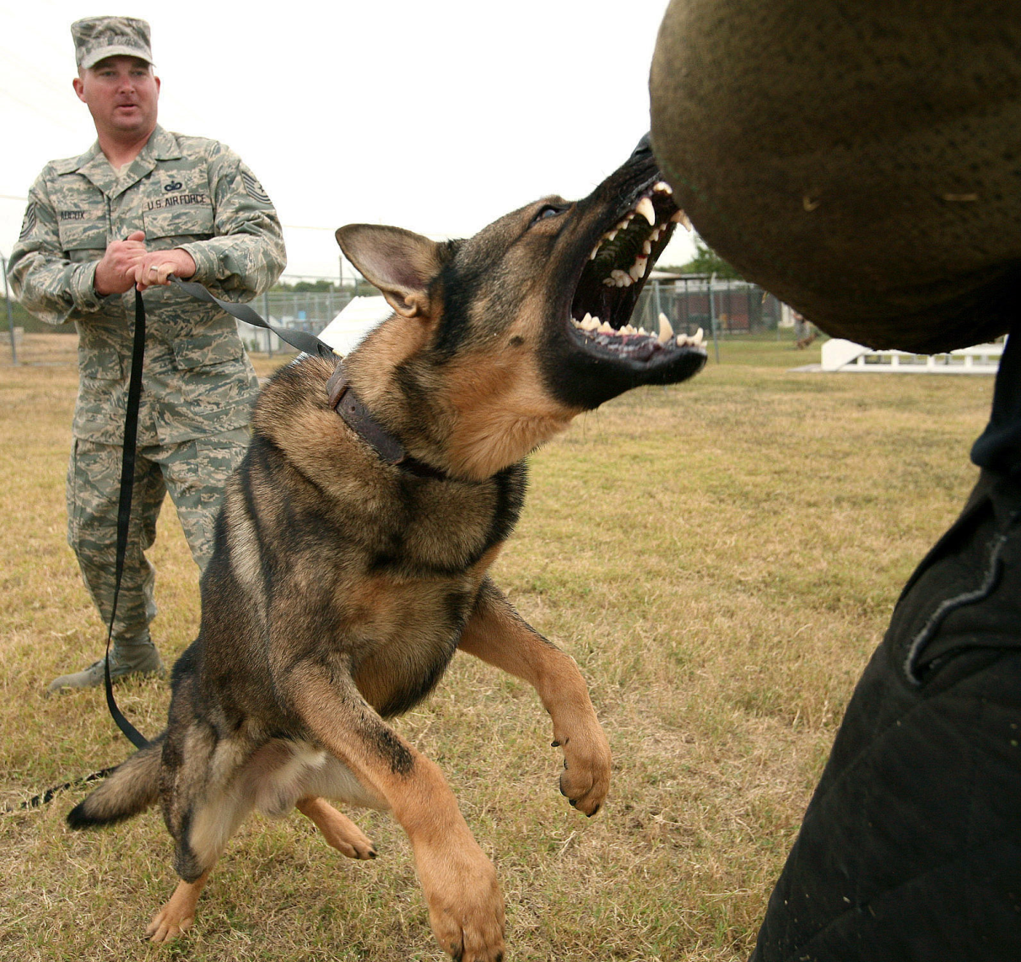
What do we want to know about this object?

Slide 38

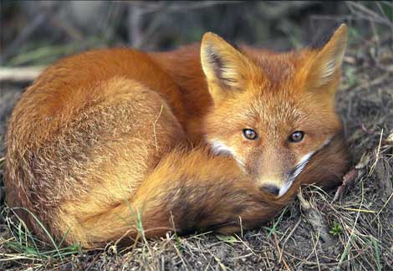
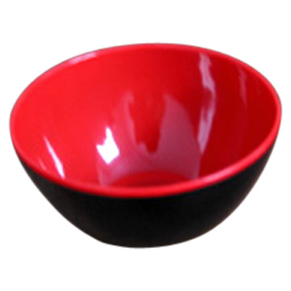
Recognition: describe, predict, or interact with the object based on visual cues
Can I poke with it?
Can I put stuff in it?
Is it alive?
What shape is it?
Is it soft?
Does it have a tail?
Will it blend?

Slide 39
The perception of function
Slide Credit: Torralba
Direct perception (affordances): Gibson
Flat surface Horizontal Knee-high …
Sittable upon
Mediated perception (categorization)
Flat surface Horizontal Knee-high …
Chair
Sittable upon

Slide 40
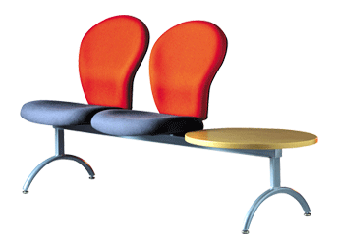
Direct perception
Slide Credit: Torralba
Some aspects of an object’s function can be perceived directly
Functional form: Some forms clearly indicate to a function (“sittable-upon”, container, cutting device, …)
Sittable-upon
Sittable-upon
Sittable-upon

Slide 41
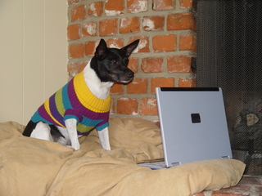
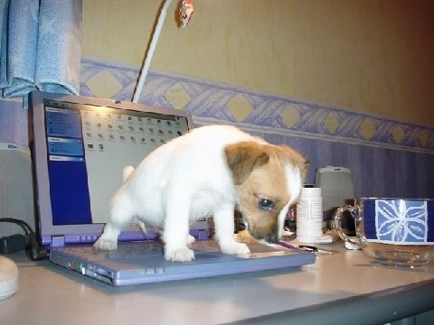
Direct perception
Slide Credit: Torralba
Some aspects of an object function can be perceived directly
Observer relativity: Function is observer dependent
From http://lastchancerescueflint.org

Slide 42
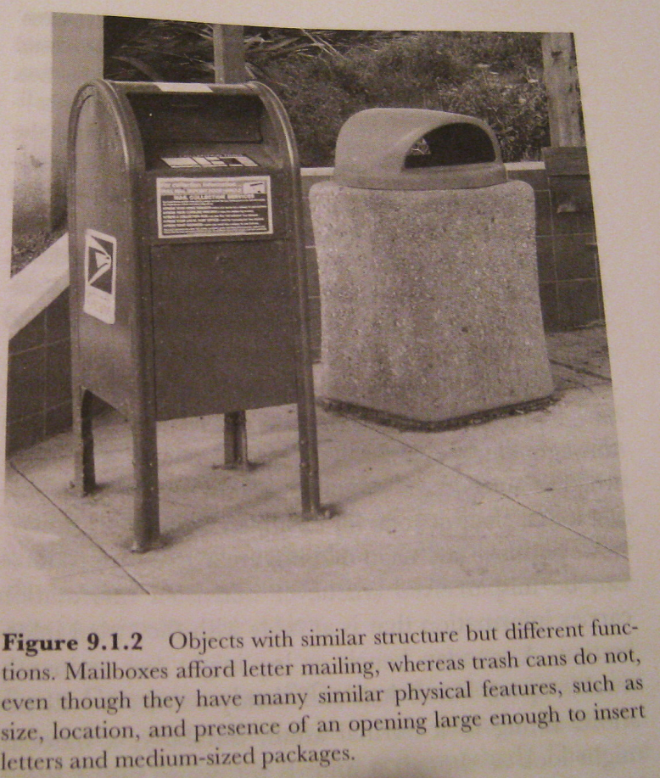
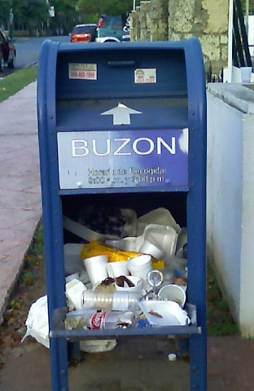
Limitations of Direct Perception
Objects of similar structure might have very different functions
Not all functions seem to be available from direct visual information only.

Slide 43
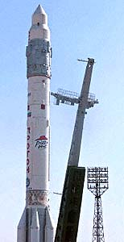

Limitations of Direct Perception
Slide Credit: Torralba
Propulsion system
Strong protective surface
Something that looks like a door
Sure, I can travel to space on this object
Visual appearance might be a very weak cue to function

Slide 44
Why do we care about categories?
From an object’s category, we can make predictions about its behavior in the future, beyond of what is immediately perceived.
Slide Credit: Torralba

Slide 45
How do you define a category?

Slide 46
Prototype or Sum of Exemplars ?
Slide Credit: Torralba
Prototype Model
Exemplars Model
Category judgments are made
by comparing a new exemplar
to all the old exemplars of a category
or to the exemplar that is the most
appropriate
Category judgments are made
by comparing a new exemplar
to the prototype.

Slide 47
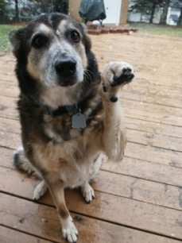
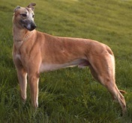
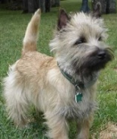
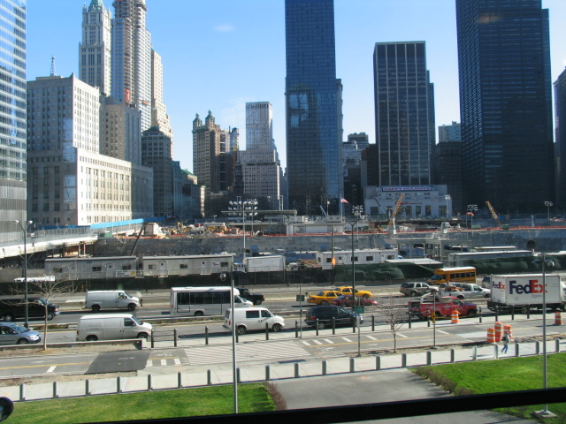

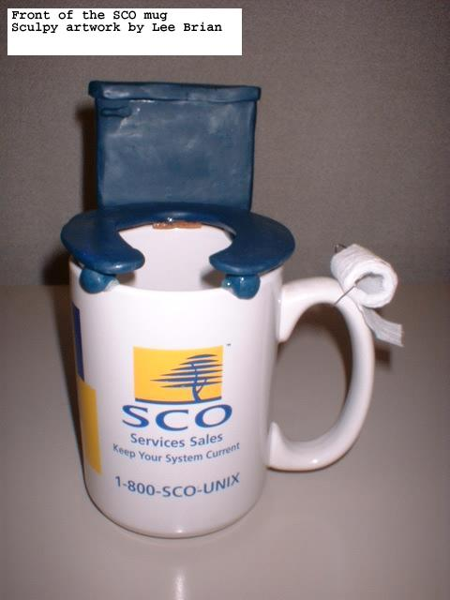
How do you define a category?
In computer vision:
LAB Histogram
x
x
x
x
x
Textons
o
x
o
x
= Object
Definition
o
o
HOG
o
x
Bag of SIFT
x
Examples
+
+
Image Features
Classifier

Slide 48
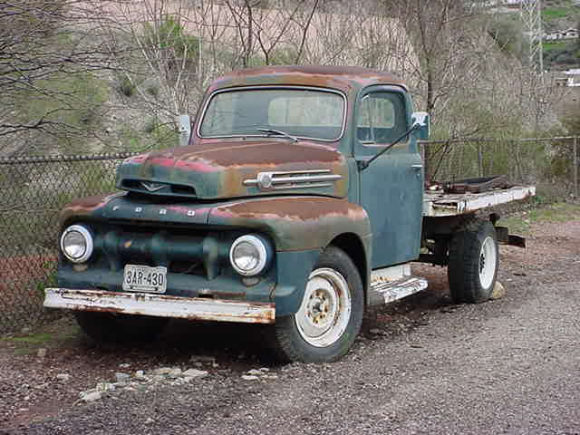
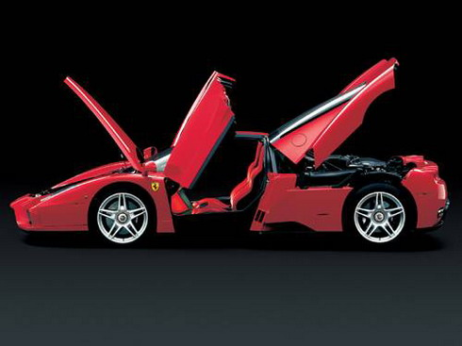
Which level of categorization is the right one?
Car is an object composed of: a few doors, four wheels (not all visible at all times), a roof,
front lights, windshield
?
Slide Credit: Torralba

Slide 49
Levels of Categorization
SUPERORDINATE LEVEL CATEGORIES
BASIC-LEVEL CATEGORIES
SUBORDINATE LEVEL CATEGORIES

Slide 50
Rosch’s Levels of Categorization
Definition of Basic Level:
Similar shape: Basic level categories are the highest-level category for which their members have similar shapes.
Similar motor interactions: … for which people interact with its members using similar motor sequences.
Common attributes: … there are a significant number of attributes in common between pairs of members.
similarity
Similarity declines only slightly going from subordinate to basic level, and then drops dramatically.
Sub Basic Superordinate

Slide 51
Levels of Categorization
Rosch et al (1976) found that
People can tell whether an object belongs to a basic-level category faster
People tend to predict the basic category (e.g., “dog”) before superordinate (“animal”) or subordinate (“cocker-spaniel”) categories
“Basic” could be different for different people (e.g., is “tree” basic, or “oak”?)

Slide 52
Typicality effects
Typicality: how good or common an item is a member of a given category.
The typical exemplar is like a representation of the average (or central tendency)
But, the representation of a category varies with experience, so does the “typical” exemplar

Slide 53
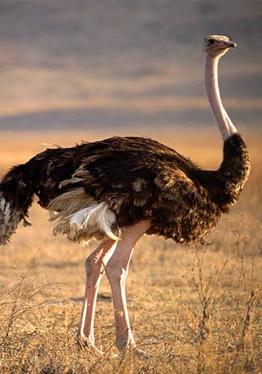
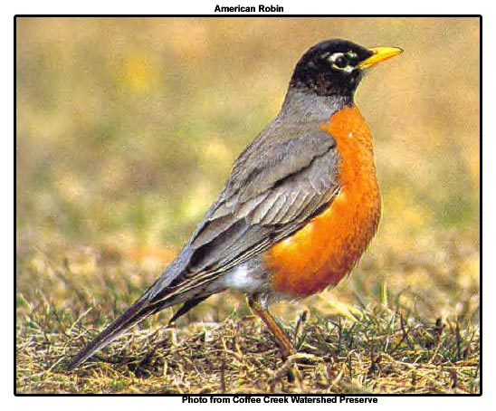
Entry-level categories (Jolicoeur, Gluck, Kosslyn 1984)
Typical member of a basic-level category are categorized at the expected level
Atypical members tend to be classified at a subordinate level.
A bird
An ostrich

Slide 54
How many categories?

Slide 55
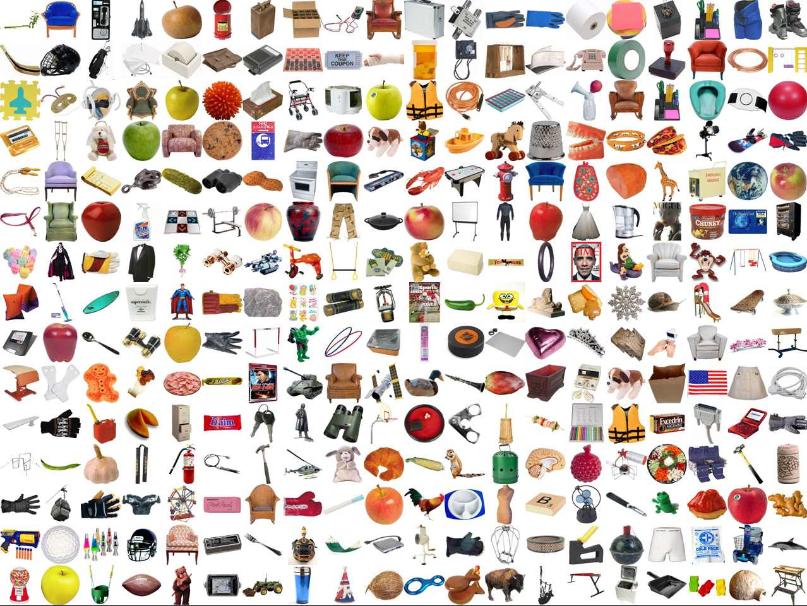
Many
Slide by Aude Oliva

Slide 56
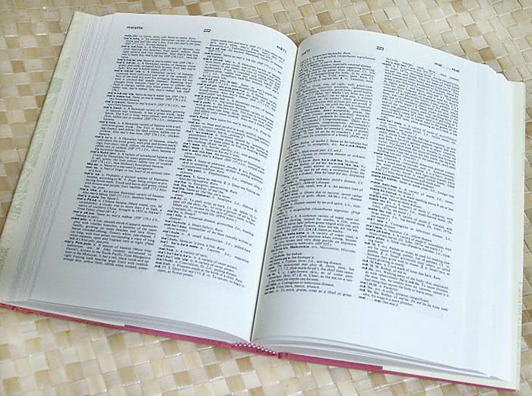

How many object categories are there?
Slide Credit: Torralba
~10,000 to 30,000
Biederman 1987

Slide 57
How many categories?
An infinite number (“the kind of person who would wear a yellow hat”)… but not all are useful

Slide 58
Beyond categories… a property-based view of recognition

Slide 59
We want detailed information about objects
“Dog”
vs.
“Large, angry animal with pointy teeth”

Slide 60
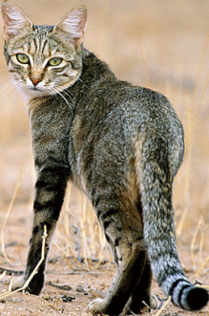
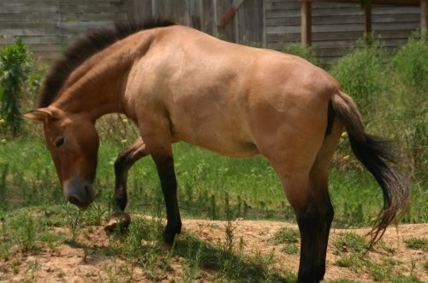

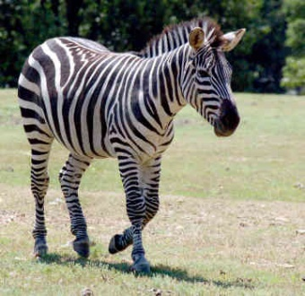
2. We want to be able to infer something about unfamiliar objects
Familiar Objects
New Object

Slide 61
2. We want to be able to infer something about unfamiliar objects
If we can infer category names…
Familiar Objects
New Object
Cat
Horse
Dog
???

Slide 62
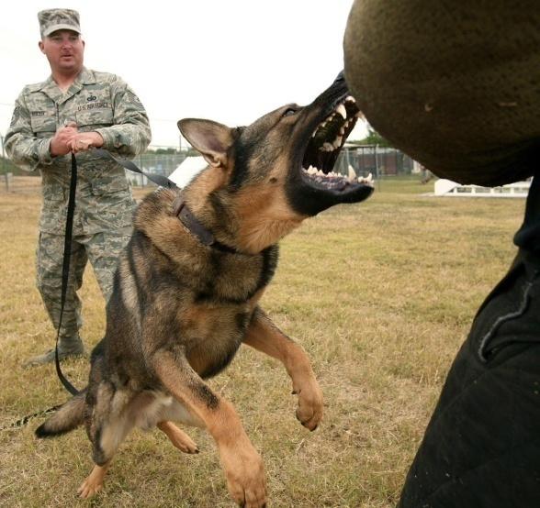


3. We want to make comparisons between objects or categories
What is unusual about this dog?
What is the difference between horses and zebras?

Slide 63
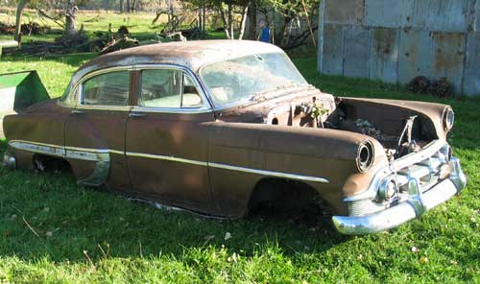

All three strategies are important
Category
associated properties
classifier
“Car”
Has Wheels
Used for Transport
Made of Metal
Has Windows
Old
No Wheels
Brown
…
Object Image
Similar Image
similarity function
associated properties
classifier for each attribute

Slide 64
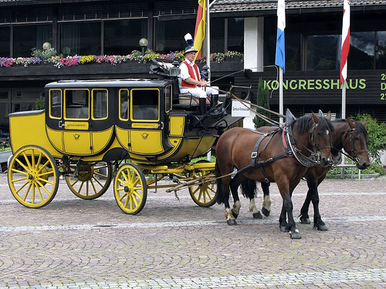
Four-legged
Mammal
Animal
Vehicle
Head
Wheel
Leg
Can run
Can Jump
Facing right
Moves on road
Farhadi Endres Hoiem 2010

Slide 65
Next class
Sliding window detectors

Slide 66
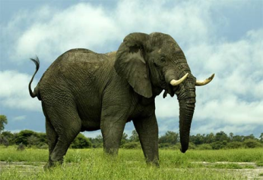
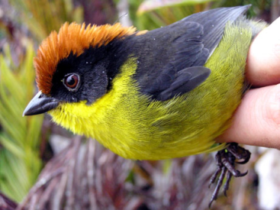
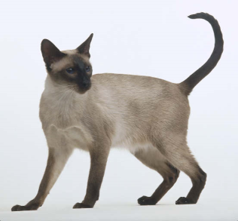

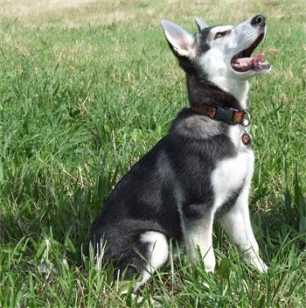

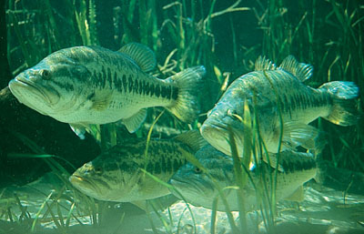
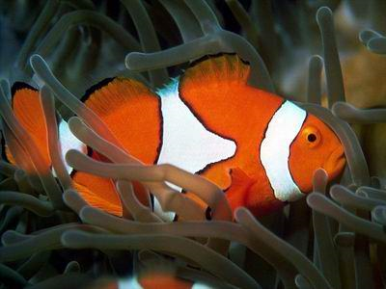
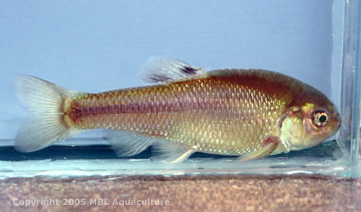
Category-based representations

Slide 67
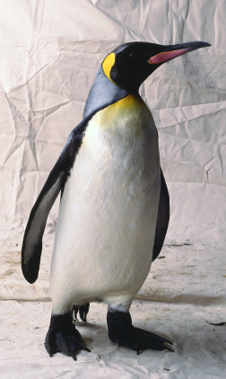
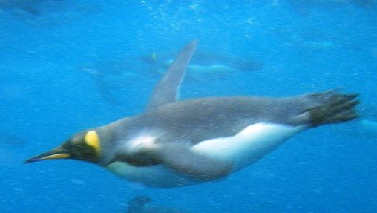
?

Slide 68
An example of categorical perception
Slide Credit: Torralba
Continuous perception: graded response
Categorical perception: “sharp” boundaries
Many perceptual phenomena are a mixture of the two: categorical at an everyday level of magnification, but continuous at a more microscopic level.
Notes:
Many perceptual phenomena are a mixture of the two: categorical at an everyday level of magnification, but continuous at a more microscopic level. It can also depend on cultural aspects, expertise, task, attention, …

Slide 69
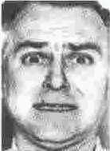
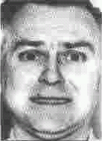
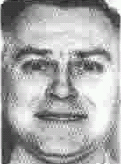
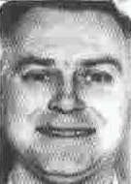

Categorical perception: “sharp” boundaries
Red vs. yellow vs. green vs. blue
fear
happiness
Identification Task
% identification
Anger
Fear
Happiness
Slide Credit: Torralba

Slide 70
Continuous perception: graded response
Dark vs. Light
20-24
25-29
30-34
35-39
40-44
45-49
50-54
Young vs. Old
Slide Credit: Torralba

Slide 71
Why do we care about categories?
Perception of function: We can perceive the 3D shape, texture, material properties, without knowing about objects. But, the concept of category encapsulates also information about what can we do with those objects.
Slide Credit: Torralba

